Slide 1

Midway Milestone Presentation: FlexiVoice
Esther G. & Rachel J.

Slide 2
Mission/Value Proposition
“Make voice interaction work for you!”
Make voice interaction easier to manage, track, and customize
Help guests communicate properly with others’ voice assistants

Slide 3
Problem/Solution Overview
People want to be flexible in how they interact with their smart devices
Our app allows you to:
Keep track of your devices
Define your own commands
Share information about your devices with others

Slide 4
Overview of Talk
Heuristic Evaluation Results
Overview of Revised Design
Prototype Implementation Status
Completed Items and Future Plans
Wizard of Oz/Hard-Coded Points
Prototype Demo

Slide 5
Heuristic Evaluation Results

Slide 6
Issues
Exiting out of popups and menus easily
User has to memorize commands to change them
User has to enter command changes for different devices manually
Too many buttons on history page
“OK” button confusing at end of tasks

Slide 7
Issues
Didn’t fix:
No way to search for a command or recipe by device
Edit/delete button for existing commands

Slide 8
Overview of Revised Design

Slide 9
Changes
Ease of use: reduced number of buttons on history page
Efficiency: Can choose multiple devices while changing a command
Recognition not recall: Added dropdown of preset commands
System status: “OK” buttons are now “Home” buttons so their function is clearer

Slide 10
Prototype Implementation Status

Slide 11
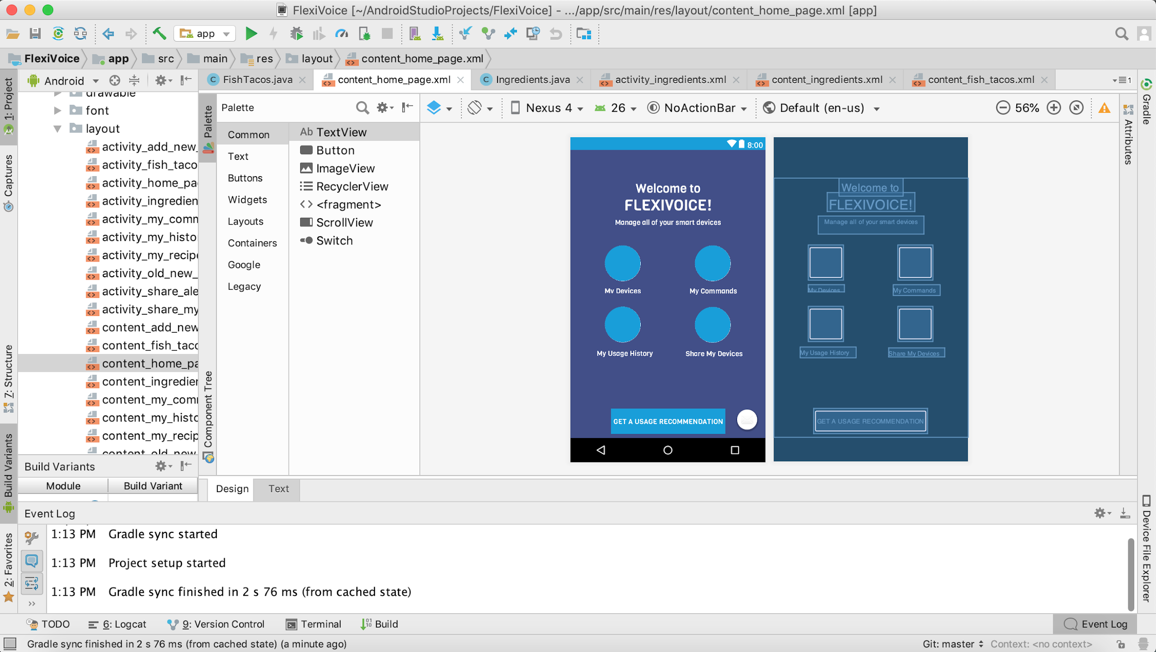
Tools Being Used
Android
Studio

Slide 12
Implemented Features
Home page UI
UI and click-through scenarios for all tasks
Pictures, icons, and back button for all tasks
Wizard of Oz and hard-coded features for all tasks

Slide 13
Unimplemented Features & Plan
Voice Interaction scenarios
Time permitting: search functionality, hamburger menu on all pages except home

Slide 14
Wizard of Oz Techniques
Share My Devices
After clicking on contact, the app shows that you’ve sent a text to this person
Create New Command:
Old and new command fields get filled with example commands
After saving, the app shows that you’ve created a command

Slide 15
Hard-Coded Data
This week’s usage on main screen (to show a week’s usage stats)
Device list (so it would look like the person has devices)
Old & new command fields (to show an example of a command pair)

Slide 16
More Hard-Coded Data
Sharing History (to show what sharing history looks like)
Contact List (so user can continue to next screen)
List of recipes and related stats (to demonstrate the search for recipe history task)
Voice: only a few commands allowed

Slide 17
Issues/Questions
UI is only optimized for Android with 5.2” screen (Nexus 5X)
How to do voice interaction in Android

Slide 18
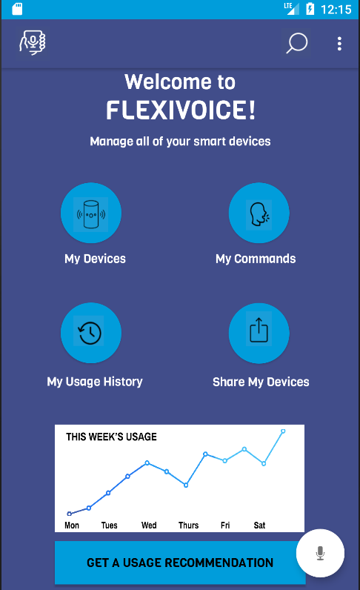
Demonstration of Prototype (Android)
Task: Add a new personalized command to your Google Home, changing it from "Google, turn on my Apple TV" to "Google, turn on my TV"

Slide 19
Summary
Changes were made to the prototype to increase usability and make the app easier to understand
Prototype was implemented on Android
Three tasks were implemented, VI to be added
Hard-coded data:
Weekly usage
Command fields
History
Contact list
Optimize for actual phone

